Slide 1
YOUR EXECUTION YEAR
Protips From Your 30th Employee
Rob Spectre, Director of Devangelism @dN0t – rob@twilio.com
Notes:
<number>

Slide 2
THIS IS YOU

Slide 3

(GO BRUINS)

Slide 4

TONIGHT WE DINE IN HASBRO

Slide 5

DELICIOUS

Slide 6

NOT NUTRITIOUS

Slide 7

STAY IN SCHOOL KIDS

Slide 8

MAYBE EVEN A PLATOON

Slide 9
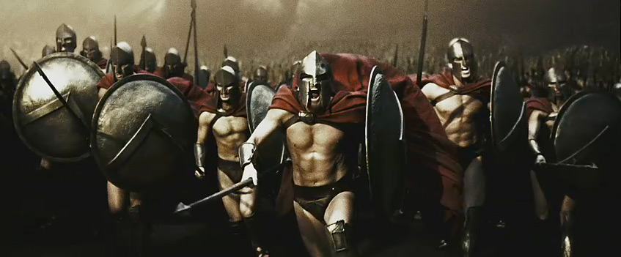
TWO 300 JOKES IN ONE DECK?

Slide 10

SERIOUSLY. STAY IN SCHOOL.

Slide 11

MAKING MONEY IS SO LAST BUBBLE

Slide 12
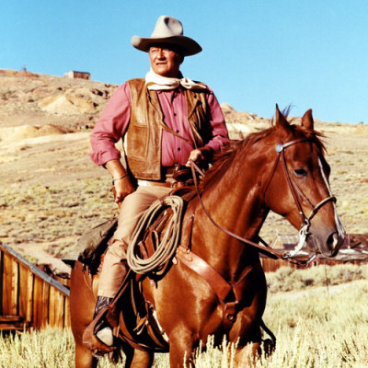
HOWDY PILGRIM

Slide 13

CHANGE YOU CAN BELIEVE IN

Slide 14
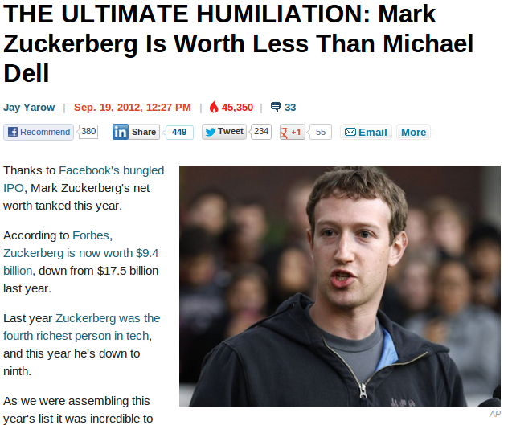
YOU KNOW WHAT'S COOL?

Slide 15
HOWDY PILGRIM

Slide 16

CLEAN THE STALLS

Slide 17
YOUR EXECUTION YEAR

Slide 18

I AM NOT ZDENO CHARA

Slide 19

YOUR OWN PROGRAMMABLE TELCO

Slide 20

WEAK BEARD? WHAT YOU SAY?

Slide 21

BUILD THAT BEARD

Slide 22

OMG I LOVE YOGA PANTS

Slide 23


#WINNING

Slide 24



#NOTSOMUCH

Slide 25

#FINGERSCROSSED

Slide 26

JESUS ROB, LIVE IN THE NOW

Slide 27

LESS HOCKEY, MORE LOL

Slide 28

ALREADY WITH THE EXPECTATIONS

Slide 29

HOPE THIS WAS TELEPHOTO

Slide 30

THE RUBY DEVELOPER MANTRA

Slide 31
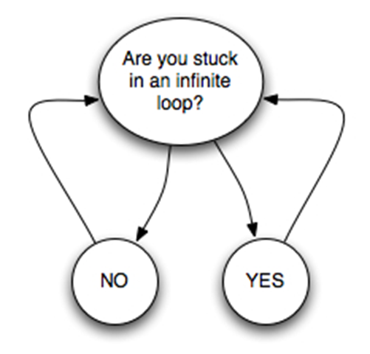
PIVOT MANIA

Slide 32

THE BOURNE SCRUM MEETING

Slide 33
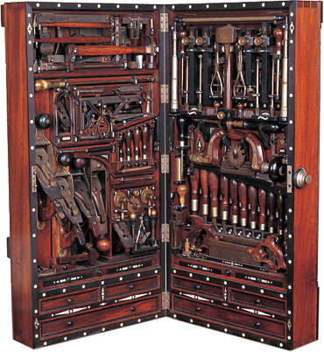
READY FOR COMIC-CON

Slide 34
HIRE LIKE HELL

Slide 35

SHHHH GUYS. YOU'LL WAKE MOM

Slide 36
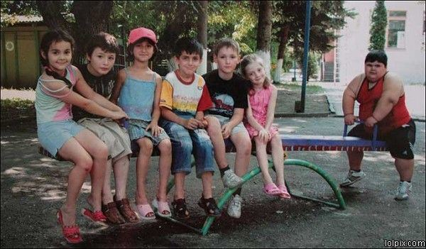
SODA IS GOOD FOR YOU

Slide 37

90'S ROMCOMS MAKE GREAT SLIDES

Slide 38

LEAST INSPIRED ILLUSTRATION

Slide 39

WORST RODIN EVER

Slide 40

I PITY THE FOOL

Slide 41

HE'S GOING THE DISTANCE

Slide 42

THIS SLIDE IS ONLY A TEST

Slide 43

GAME OF THRONES REFERENCE

Slide 44
SELL AT SCALE

Slide 45

THE RECORD PUNK ROCK FORGOT

Slide 46

GREAT CONVERSION STEVE

Slide 47

I LOVED YOU ON SNL

Slide 48

SIMPLE EFFECTIVE

Slide 49
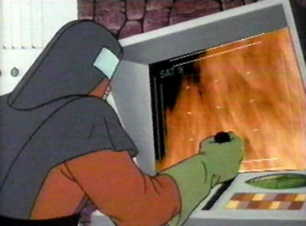
SWEET. CHIPS.

Slide 50

ONE THROAT TO CHOKE

Slide 51
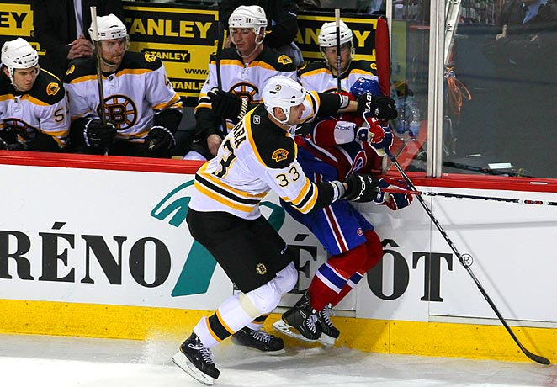
CLEAN HIT

Slide 52
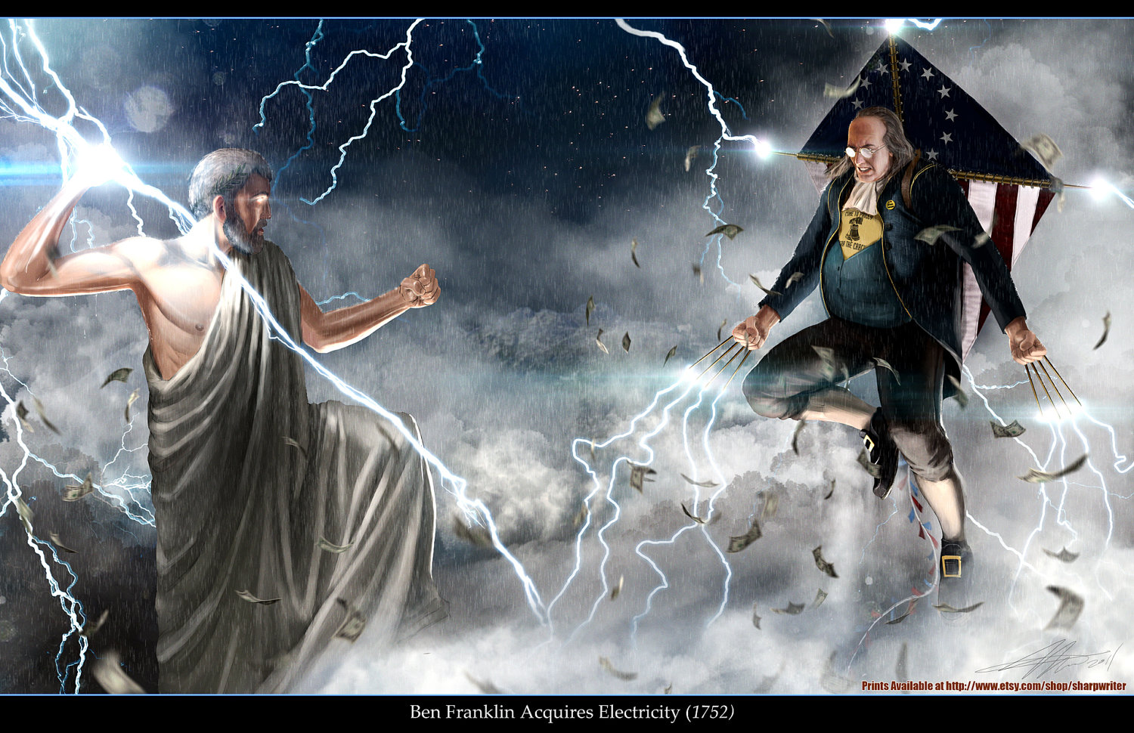
EPIC PROPORTIONS

Slide 53
STAY HUNGRY

Slide 54

WHICH COUNTRY SHOULD I BUY

Slide 55
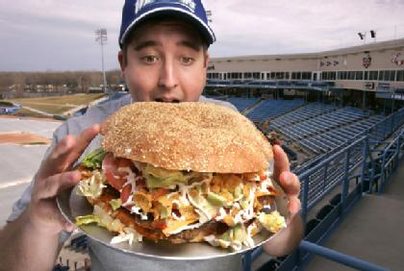
'MERICA. YEAH.

Slide 56

EASY MONEY

Slide 57

LIFE IS BETTER UP HERE

Slide 58
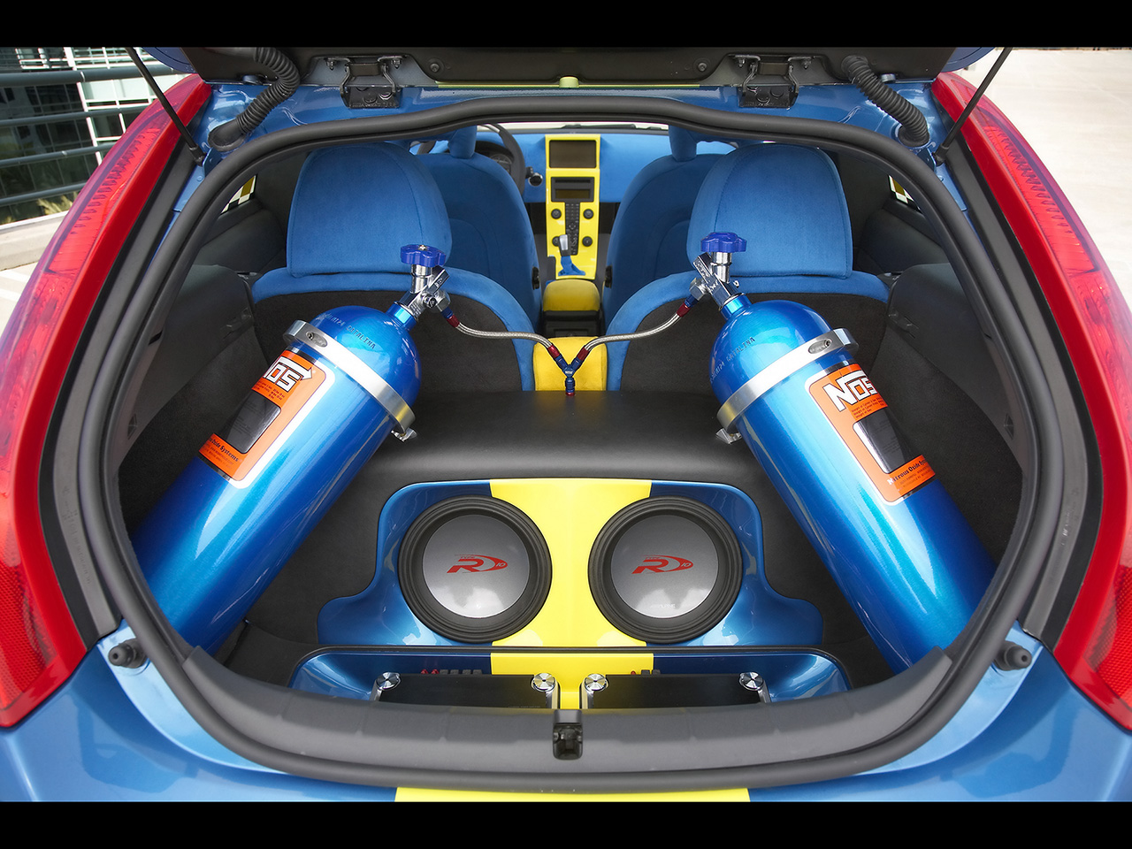
INVEST IN SPEED

Slide 59

INVEST IN YOUR CRIB

Slide 60

INVEST IN YOUR CRIB

Slide 61

PONIES? MEH.

Slide 62

ROBOT UNICORNS? YEAH.

Slide 63
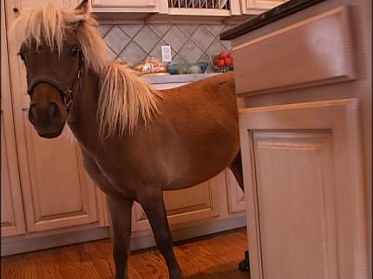
O HAI.

Slide 64
FAIL FAST, OFTEN AND SMALL

Slide 65
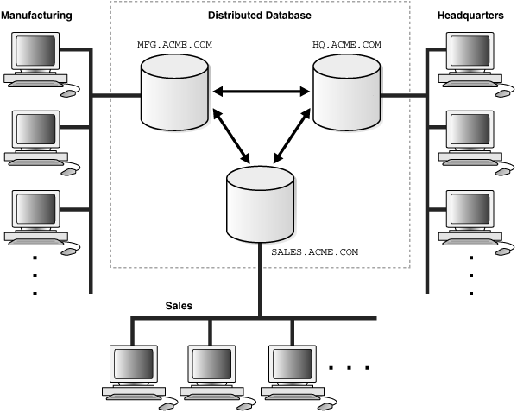
GENERIC NETWORK DIAGRAM

Slide 66

EVERYTHING IN SCOPE

Slide 67

I WANT A WASHER THAT LOOKS LIKE A TIE FIGHTER

Slide 68

HELLO NURSE

Slide 69
OBSESS OVER THE CUSTOMER

Slide 70
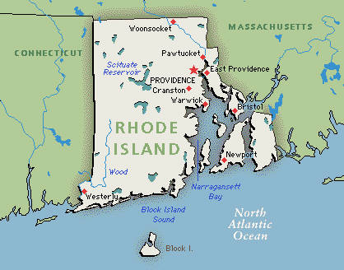
STRETCH THE SCALE STILL LOOKS TINY

Slide 71

FACEPALM

Slide 72
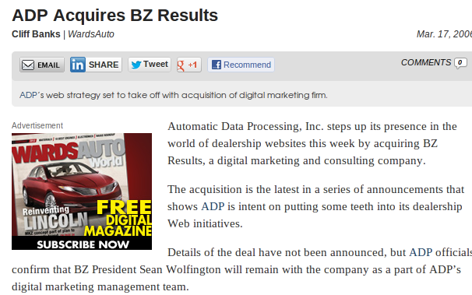
EXIT

Slide 73
CONCLUSIONS

Slide 74
GIDDY UP

Slide 75
THANK YOU
github.com/RobSpectre/Talks
www.brooklynhacker.com @dN0t – rob@twilio.com
Notes:
<number>

